Slide 1
Intermediate Presentation
- Interactive Score Annotation for MIR -
Fernando Perry de Azeredo
up202308655@up.pt
FEUP 2026

Slide 2
Thesis & Dissertation Goal
To create a new Beat Annotation GUI tool.

Slide 3
BeatMapJS (09/2025 - 02/2026 )
Goal: Make a basic beat annotation GUI tool
Tools used: JS/HTML based, BeatThis!, Wavesurfer.JS,
Developed Features:
  Interactive Spectogram
  Web-based interface in JS/HTML
  Beat This! Integration
  Beat Annotation basic tools
  Region Annotation
  Table for editing tempo annotations and descriptions
  Ability to import/export beat annotations to .txt.
Conclusion: No significant contribution for MIR.

Slide 4
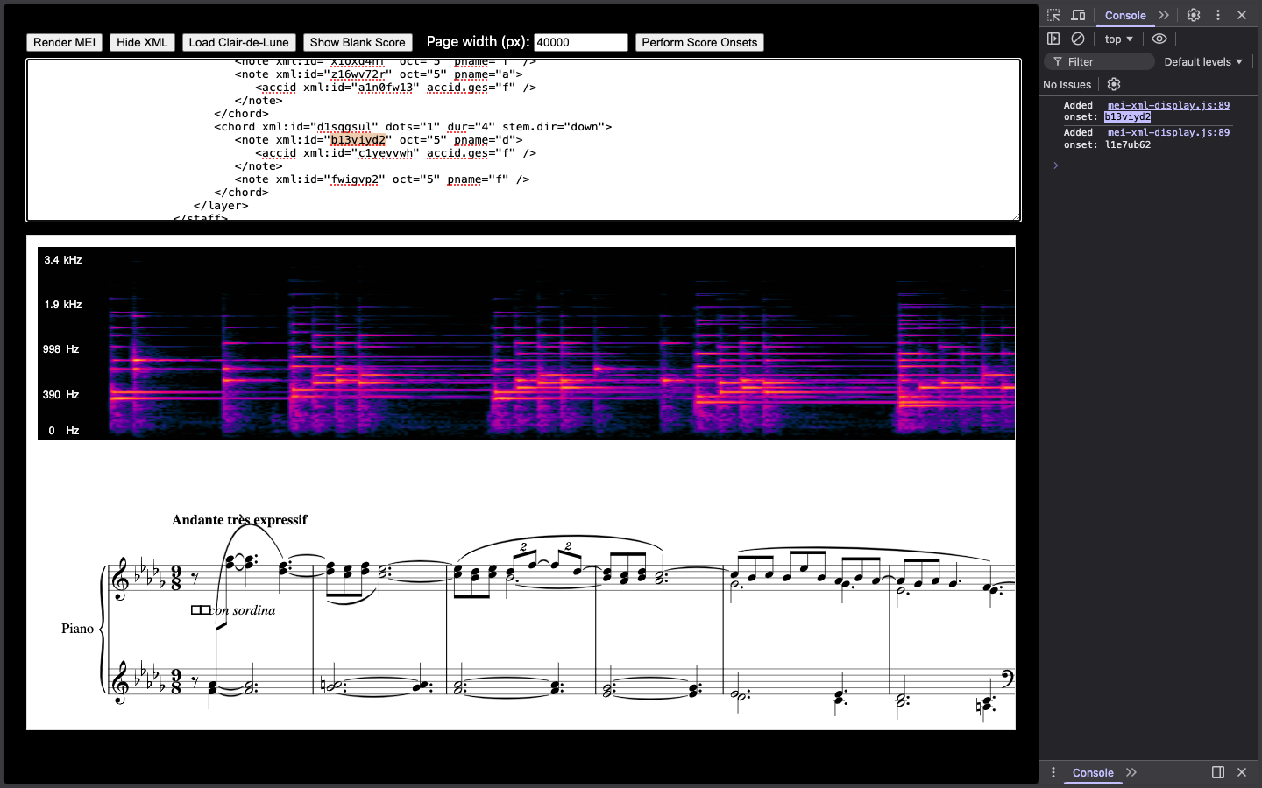
MEI-Basic-Edit (02/2025 - 03/2026 )
Goal: Understand how MEI scores can be manipulated.
Tools Used: JS/HTML, Verovio, SVG, MEI format.
Developed Features:
  MEI Score display.
  XML text editor.
Conclusion: Failed project, however gave me insight on MEI format and Verovio.

Slide 5
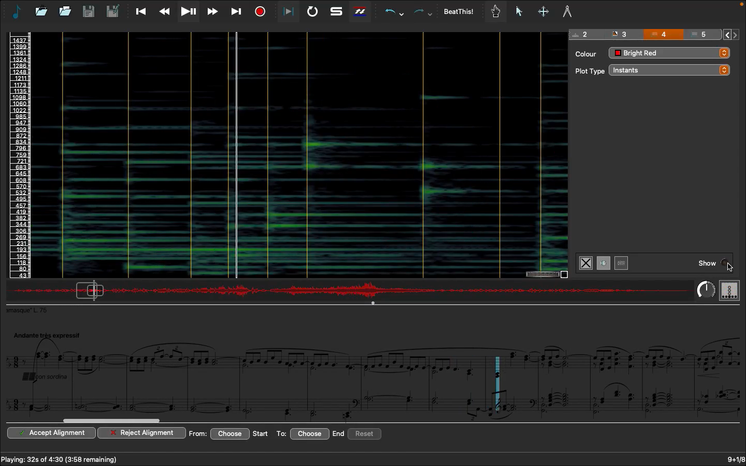
Piano-Precision Fork (03/2025 - 03/2026 )
Goal: To make a Beat Annotation fork of Sonic Visualizer
Developed Features: Beat This! Integration, Automatic Score follow along.
Conclusion: No significant academic contribution.

Slide 6
Score-Allignment.py (03/2025 - 03/2026 )
Goal: Spectogram and Score Visualizer in python
Tools used: Modusa (matplot lib)
Developed Features:
Navigational Spectrogram
Conclusion: Spent way to much time trying to make the spectogram better.

Slide 7
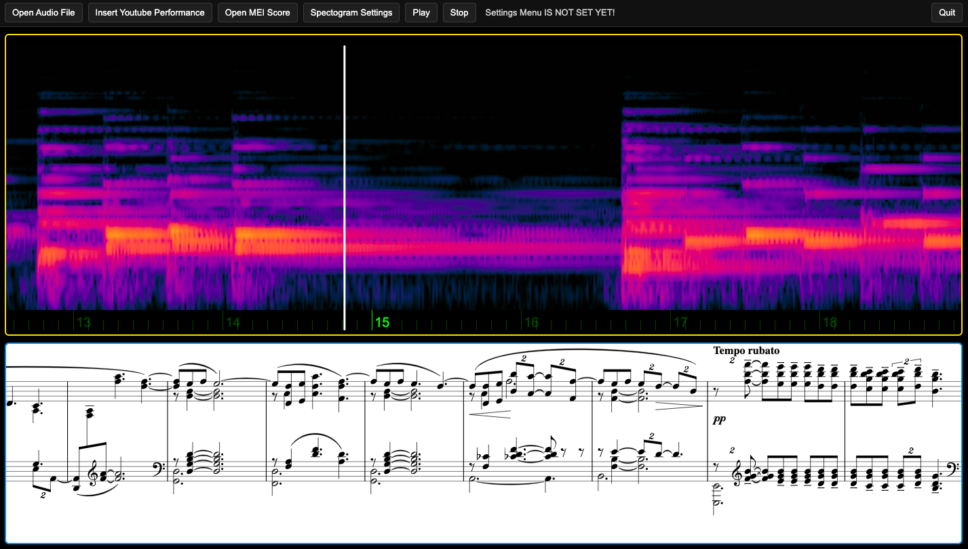
Score-Allignment.js (03/2025 - 03/2026 )
Goal: Redo in JS
Tools used: Wavesuurfer.js and Verovio.
Developed Features:
MEI visualizer
Ability to make time markers within .mei score.
Conclusion: No significant academic addition.

Slide 8
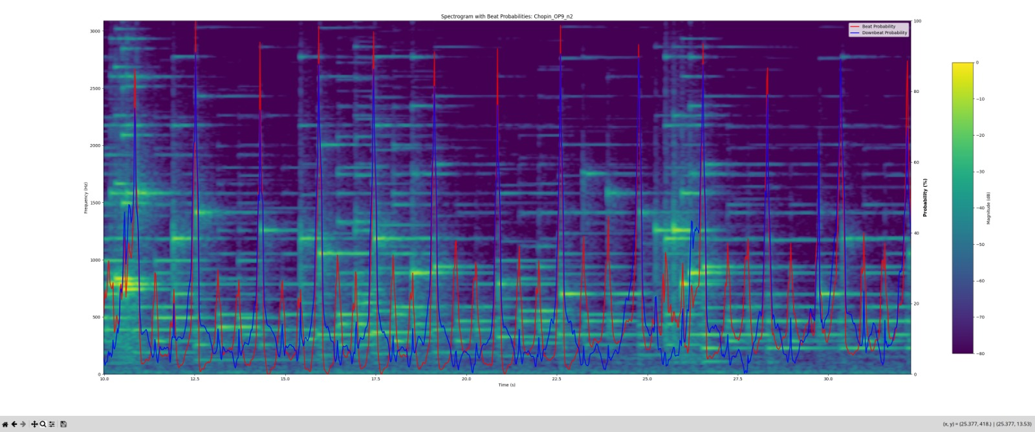
Score-Allignment.js (03/2025 - 03/2026 )
Goal: Make spectogram and score alignment
Goal: Make spectogram and score alignment
Goal: Make spectogram and score alignment
Goal: Make spectogram and score alignment

Slide 9
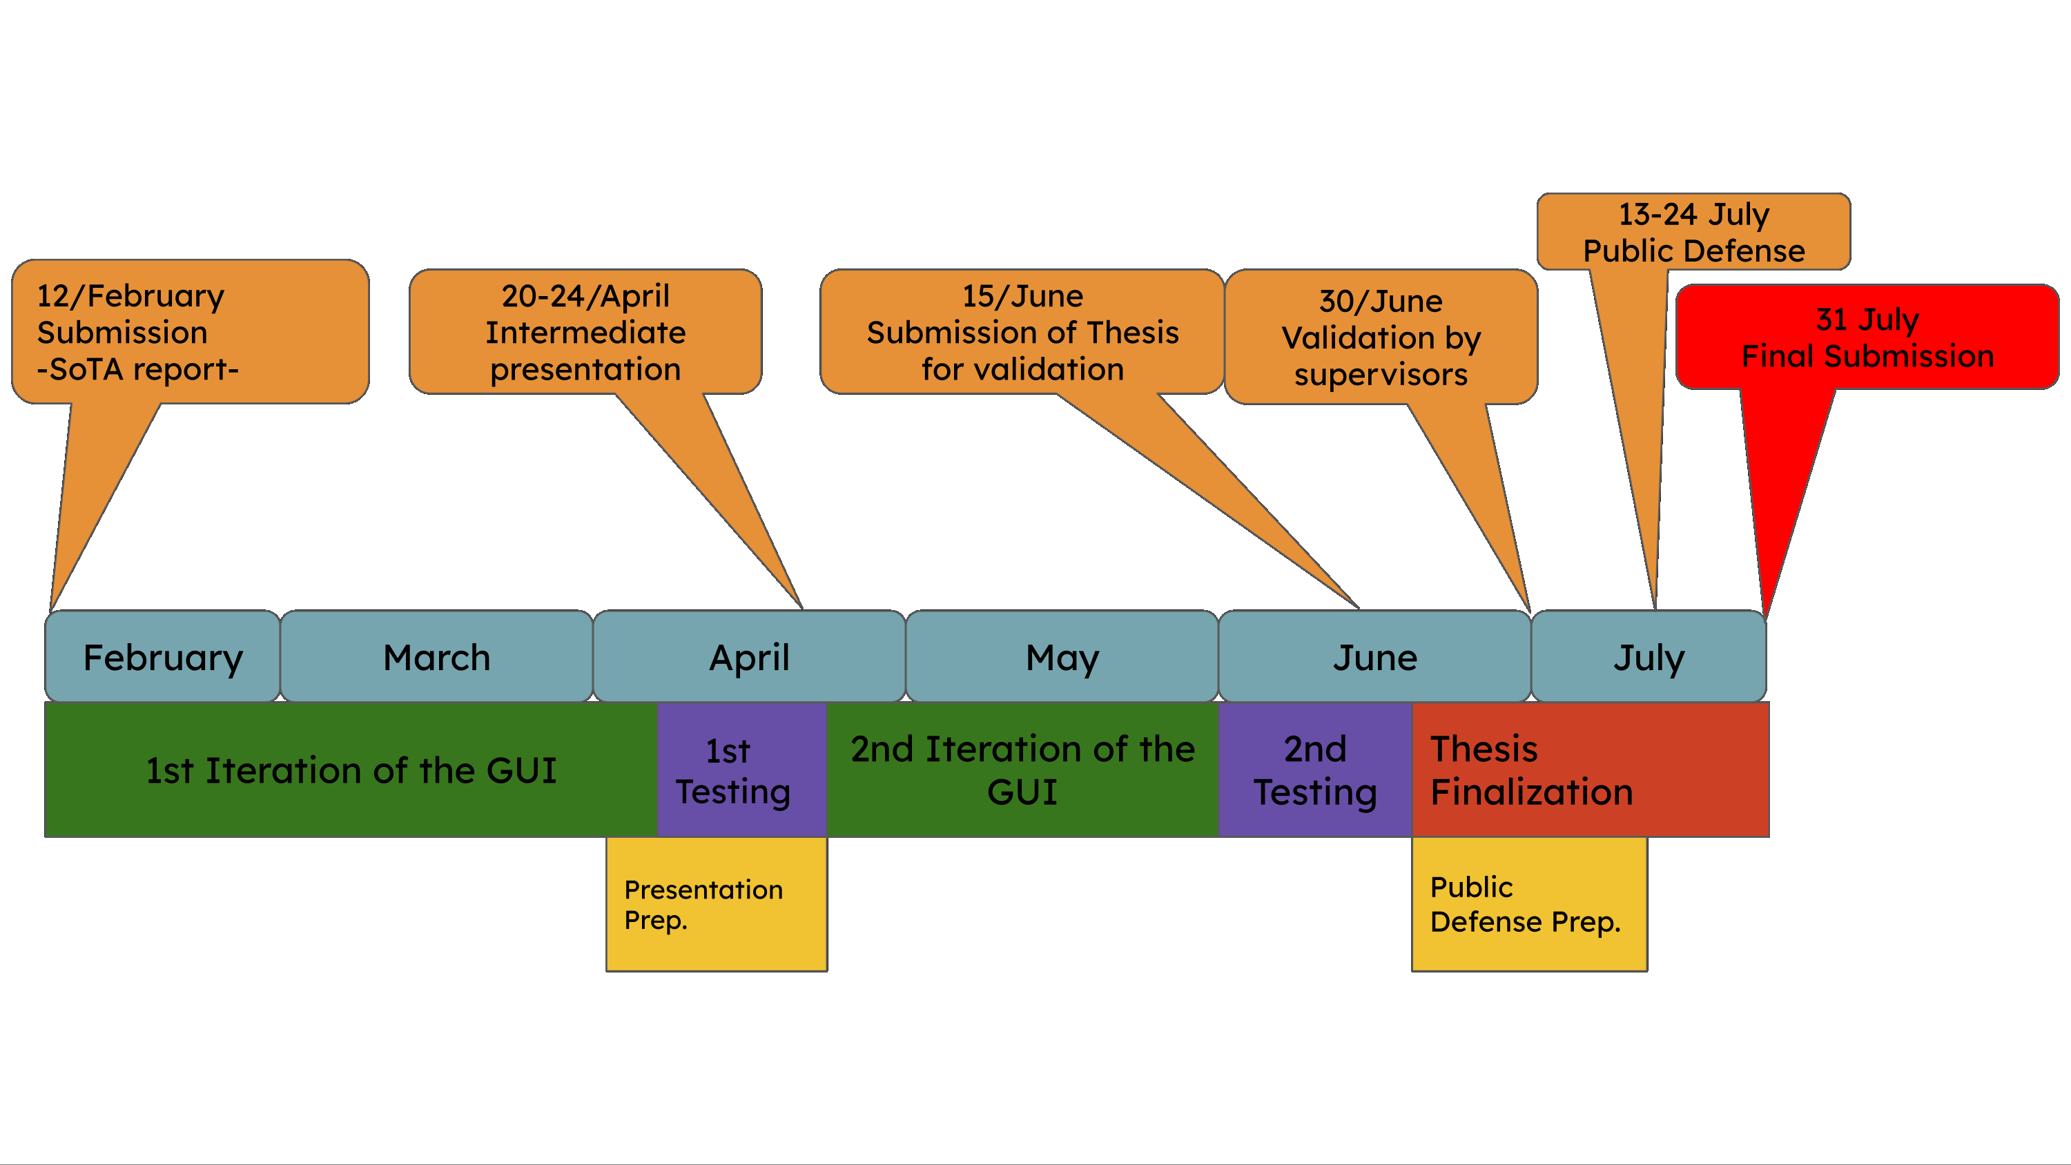
Sota Timeline and Goals

Slide 10
What is going good
I now have a better understanding of:
  Beat Tracking Algorithms
  Verovio and the benefits of MEI format in MIR.
  General understanding and experience in coding on Python and JS.

Slide 11
What went bad
Feels like most of the effort I did for the thesis project, was for nothing.
Should have given more updates to my supervisor since day1.
I feel like, my programing knowledge was not enough for the task.

Slide 12
How it is going
Feels like most of the effort I did for the thesis project, was for nothing.
I am tiered.
I am frustrated.
I am sad.
More importantly, I don’t want to post-pone.
Should have given more updates to my supervisor since day1.

Slide 13
Status
Current work status: Late
Conclusion forecast: Alarming

